Slide 1


Morning/Evening Star Candlesticks Patterns
Comparing
Technical Indicators
By Sarah

Slide 2

OBJECTIVE
The objective of this presentation is to evaluate and compare the performance of two trading strategies that combine popular indicators with Candlestick patterns.
Specifically, we will examine the effectiveness of combining the Exponential Moving Average (EMA) with Morning star pattern/Evening star pattern and the Moving Average Convergence Divergence (MACD) with Morning star pattern/Evening star pattern .
The aim is to determine which strategy demonstrates superior performance in identifying potential trend reversals, generating accurate trading signals, and maximizing profit potential.
By analyzing historical data and key performance metrics, we seek to provide insights into the effectiveness of these combined strategies and their potential value in enhancing trading decisions.

Slide 3
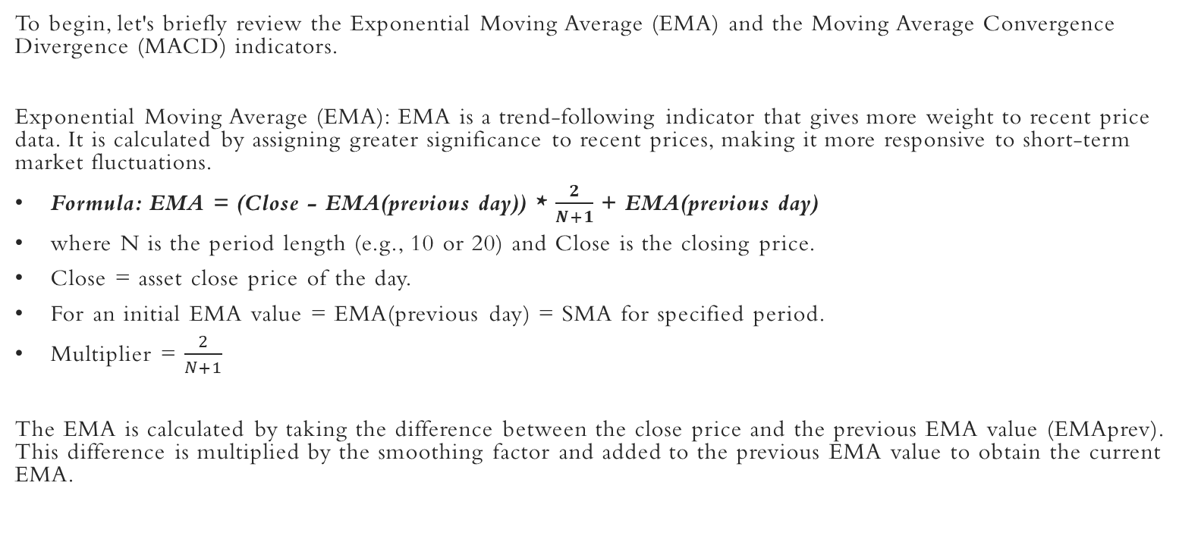
OVERVIEW OF THE EMA AND FORMULA

Slide 4
Performance Comparison of EMA and MACD
Now, let's compare the performance of EMA and MACD in identifying reversals. We will analyze historical price data and assess the accuracy of each indicator in predicting price reversals.
Data Selection: We will use the SPY and select a substantial time period to ensure reliable results.
Evaluation Criteria: We will consider factors such as the reversal signals, and the magnitude of price movements following the signals.
Statistical Analysis: We will employ appropriate statistical measures, such as actual returns vs strategy returns, cumulative returns vs cumulative strategy returns, and sharpe ratio, to quantitatively assess the performance of EMA and MACD.

Slide 5
OVERVIEW OF THE MORNING/EVENING STAR CANDLESTICK
Morning Star and Evening Star are candlestick patterns that provide potential indications of trend reversals.
The Morning Star pattern occurs during a downtrend and suggests a potential bullish reversal. It consists of three candles.
The first candle is a relatively long bearish (red or black) candle, indicating selling pressure.
The second candle is a smaller candle that can be bullish or bearish. It represents indecision in the market.
The third candle is a bullish (green or white) candle that closes well above the midpoint of the first candle. It signifies a potential shift in sentiment from bearish to bullish.
The Evening Star pattern occurs during an uptrend and indicates a potential bearish reversal. It also consists of three candles.
The first candle is a relatively long bullish (green or white) candle, representing buying pressure.
The second candle is a smaller candle, usually with a small body, indicating indecision.
The third candle is a bearish (red or black) candle that closes well below the midpoint of the first candle. It suggests a potential shift from bullish to bearish sentiment.

Slide 6
ENTRY AND EXIT CONDITIONS EMPLOYED FOR EMA
Buy Entry: When the 10 period EMA is > 20 period EMA.
Exit: When an evening star pattern forms.
Sell Entry: When the 10 period EMA is < 20 period EMA.
Exit: When a morning star pattern forms.

Slide 7
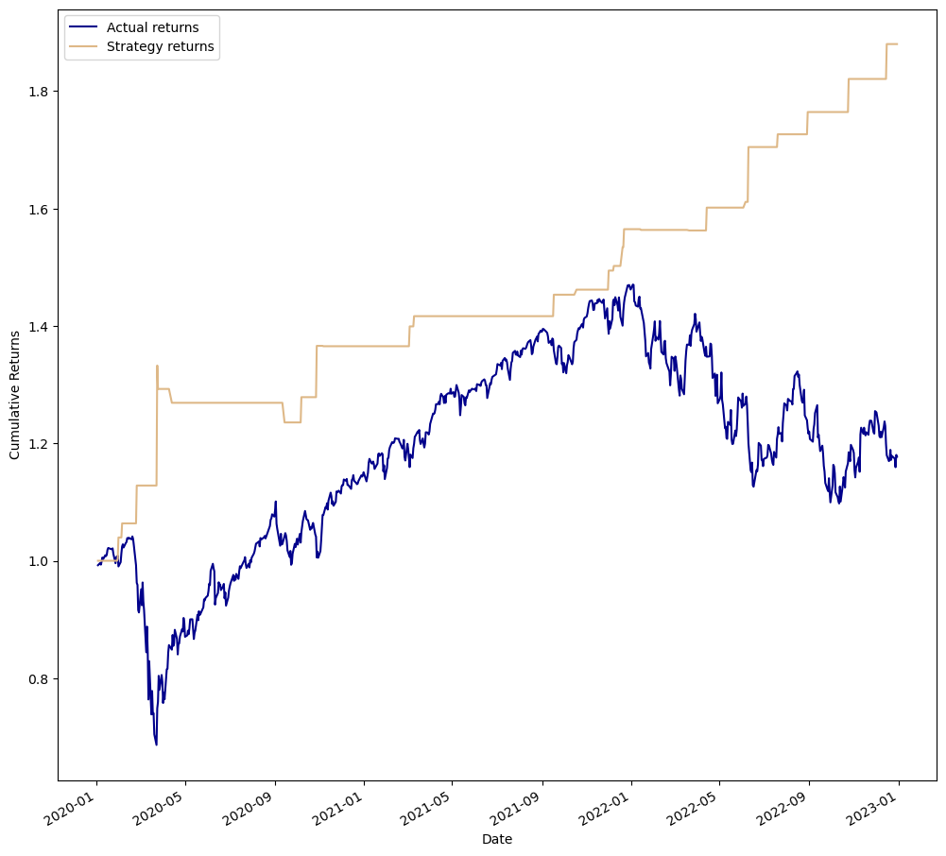
Strategy Backtest Result

Slide 8
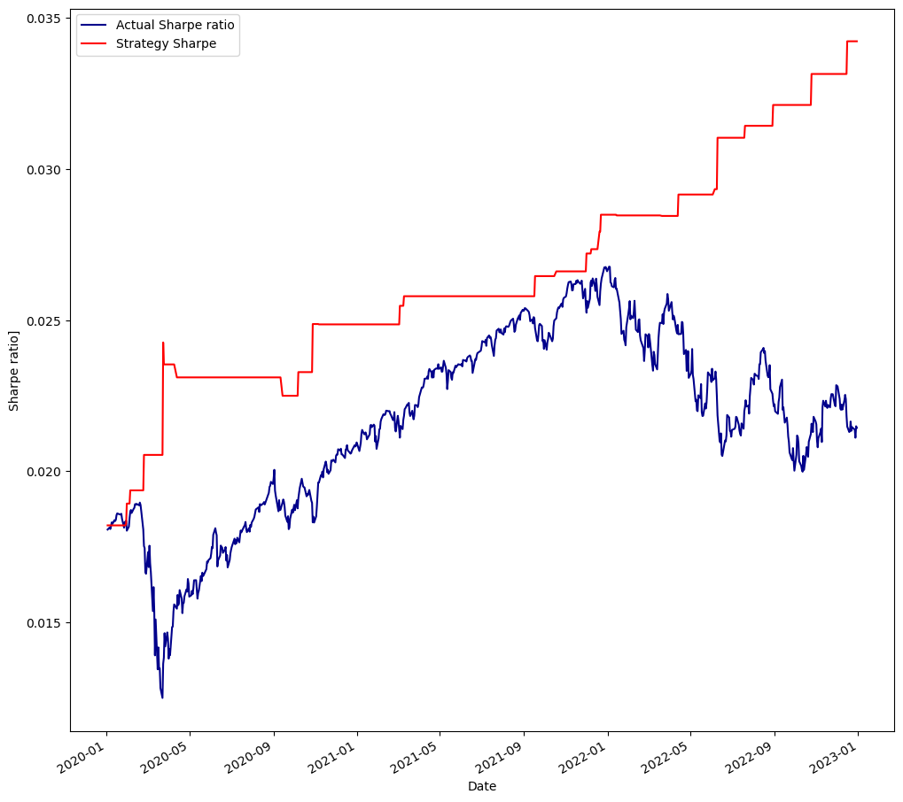
Sharpe Ratio Result

Slide 9
OVERVIEW OF THE MACD AND FORMULA
Moving Average Convergence Divergence (MACD): MACD is a versatile indicator that combines trend-following and momentum characteristics. It consists of two lines: the MACD line, which represents the difference between two moving averages, and the signal line, which is a moving average of the MACD line. The MACD line crossing above or below the signal line is often considered a potential reversal signal.
It is calculated as follows:
MACD=12-Period EMA − 26-Period EMA
Signal line = 9- period EMA of MACD Line
Histogram = MACD line - Signal line

Slide 10




ENTRY AND EXIT CONDITIONS EMPLOYED FOR MACD
Buy Entry: MACD line > Signal line.
Exit: When an evening star pattern forms.
Sell Entry: MACD line < Signal line.
Exit: When a morning star pattern forms.

Slide 11
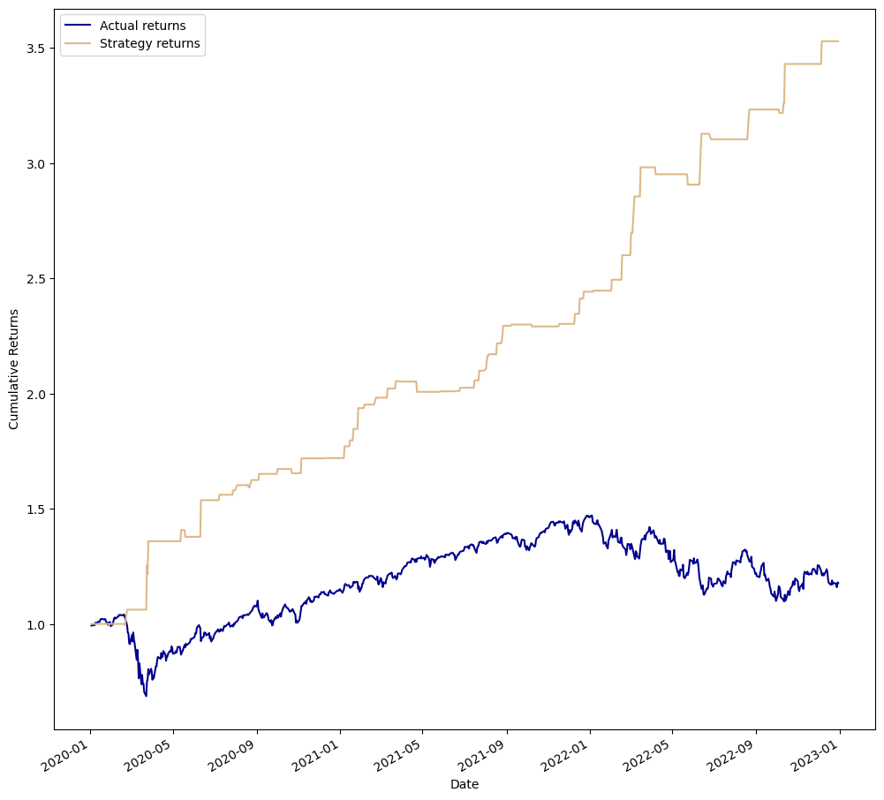
Strategy Backtest Result

Slide 12
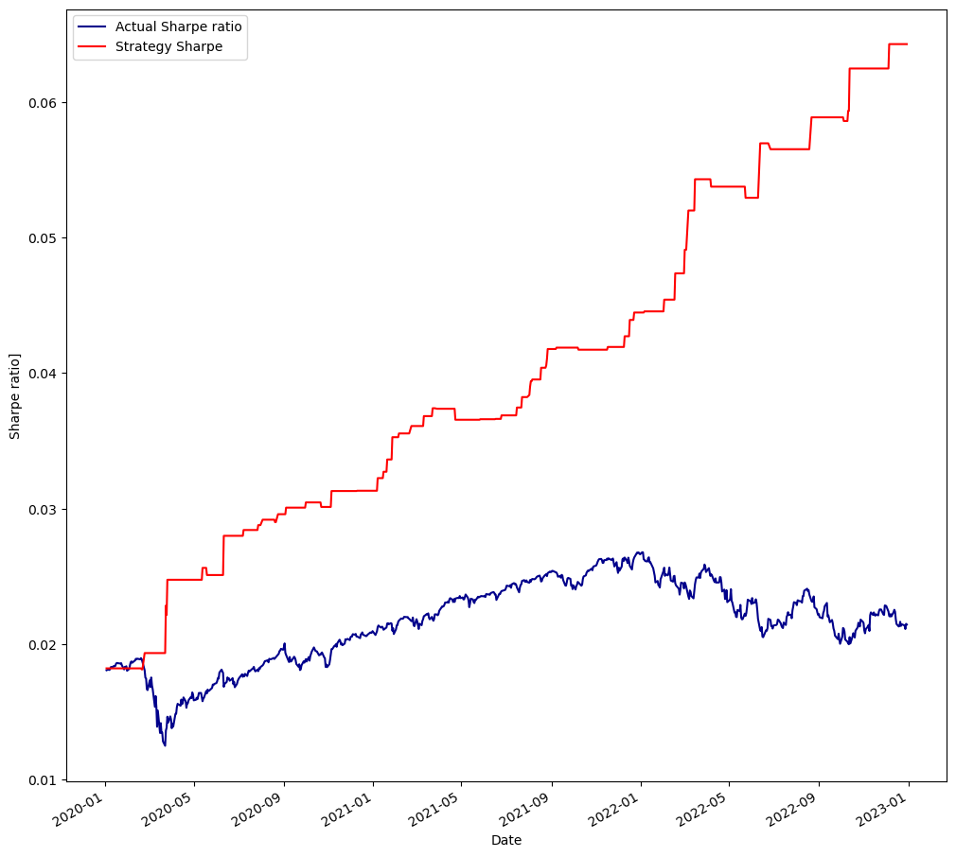
Sharpe Ratio Result

Slide 13

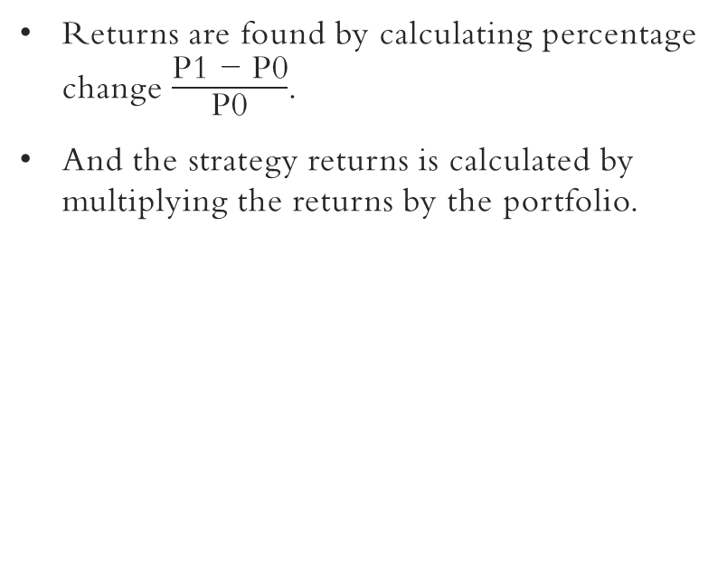
RETURNS FORMULA

Slide 14
FINDINGS
Based on the analysis conducted, it has been found that the combination of the MACD indicator with the Morning and Evening star candlestick pattern, and the combination of the EMA indicator with the Morning and Evening star candlestick pattern, both generated profitable returns.
However, the strategy using the MACD and Morning and Evening star candlestick pattern exhibited stronger performance compared to the EMA and Engulfing Candlestick pattern strategy.
The MACD and Engulfing Candlestick strategy produced returns of 3.5 times the initial investment. This indicates that the strategy effectively captured potential trend reversals and generated profitable trading signals.
On the other hand, the EMA and Engulfing Candlestick strategy generated returns of 1.8 times the initial investment. Although still profitable, the performance of this strategy was comparatively lower than that of the MACD and Engulfing Candlestick strategy.

Slide 15
Conclusion
These findings suggest that the MACD indicator, which combines trend-following and momentum characteristics, complemented the Morning and Evening Star Candlestick pattern more effectively, leading to more accurate identification of potential reversals and stronger trading signals.
The EMA, although useful as a trend-following indicator, may have exhibited slightly less precision in conjunction with the Morning and Evening Star Candlestick pattern.
In summary, based on the analysis conducted, the strategy combining the MACD indicator with the Morning and Evening Star Candlestick pattern demonstrated stronger performance compared to the strategy combining the EMA indicator with the Morning and Evening Star Candlestick pattern.
Traders may consider incorporating the MACD and Morning and Evening Star Candlestick pattern strategy into their trading approach, but should also continue to evaluate and adapt the strategy to align with their individual goals and changing market conditions.

